Slide 1
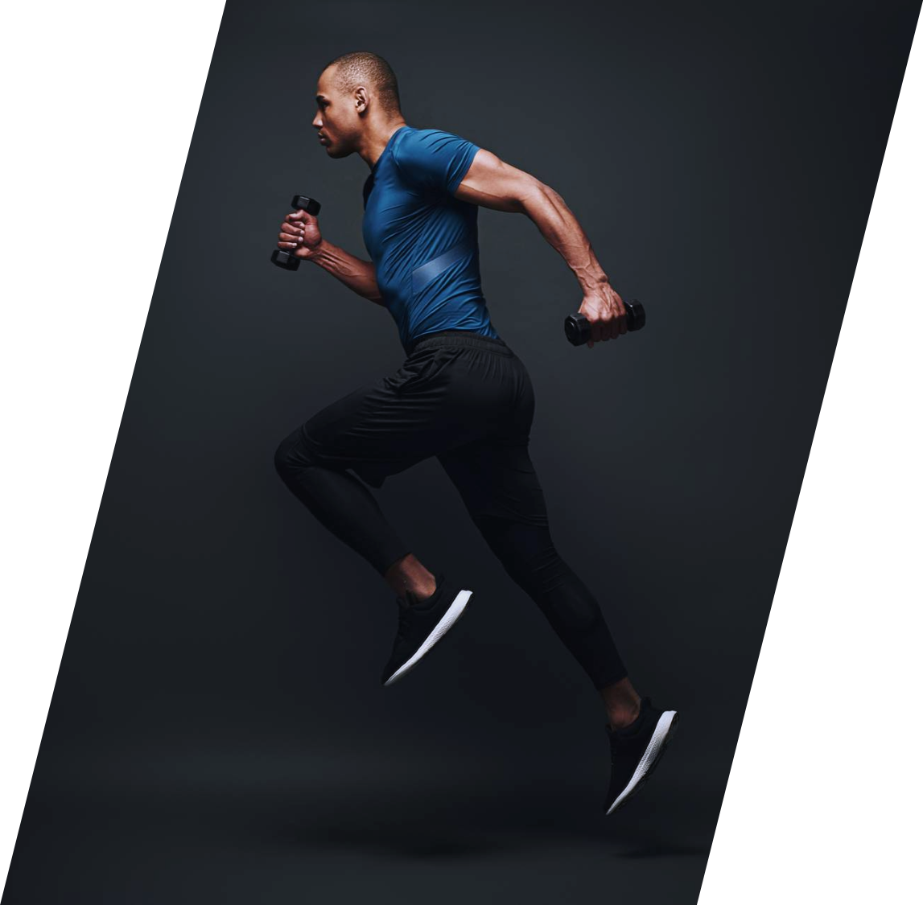
FIT-BUDDY
PERSONAL
TRAINING
PERSONAL
TRAINING
PERSONAL
TRAINING
PERSONAL
Your personal Workout Generator
PYTHON MINI PROJECT

Slide 2
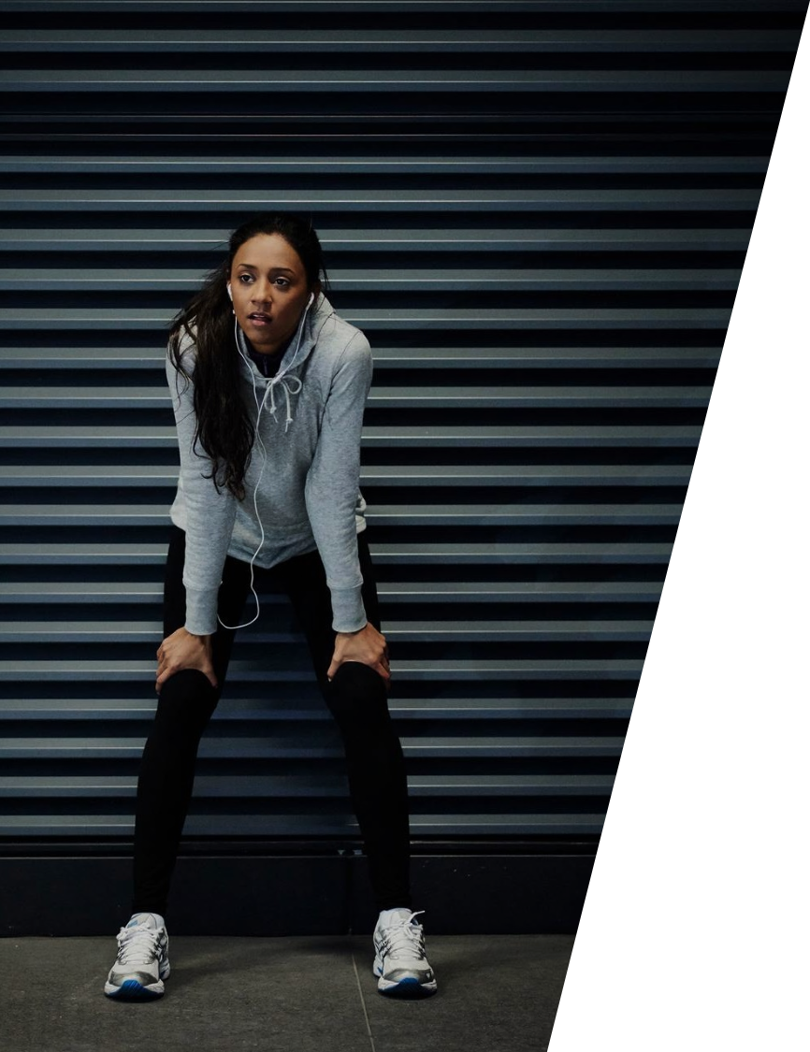
PROBLEM
The past few years has taken a toll on the physical Health of billions of people across the globe.
Staying safe in a post-pandemic world means maintaining a healthy immune system, becoming physically active, eating well and maintaining a healthy body weight.
HECTIC SCHEDULES HAVE A PART TO PLAY IN BAD PHYISICAL HEALTH OF PEOPLE.
Also, There is a direct correlation between obesity and developing serious COVID-19 complications and chronic diseases. In fact, about 78 percent of people who have been hospitalized, needed a ventilator, or died from COVID-19 have been overweight or obese, according to the Centers for Disease Control and Prevention (CDC). And once the scourge of COVID has passed, the leading causes of death will continue to be heart disease and cancers — all exacerbated by physical inactivity and overweight.

Slide 3
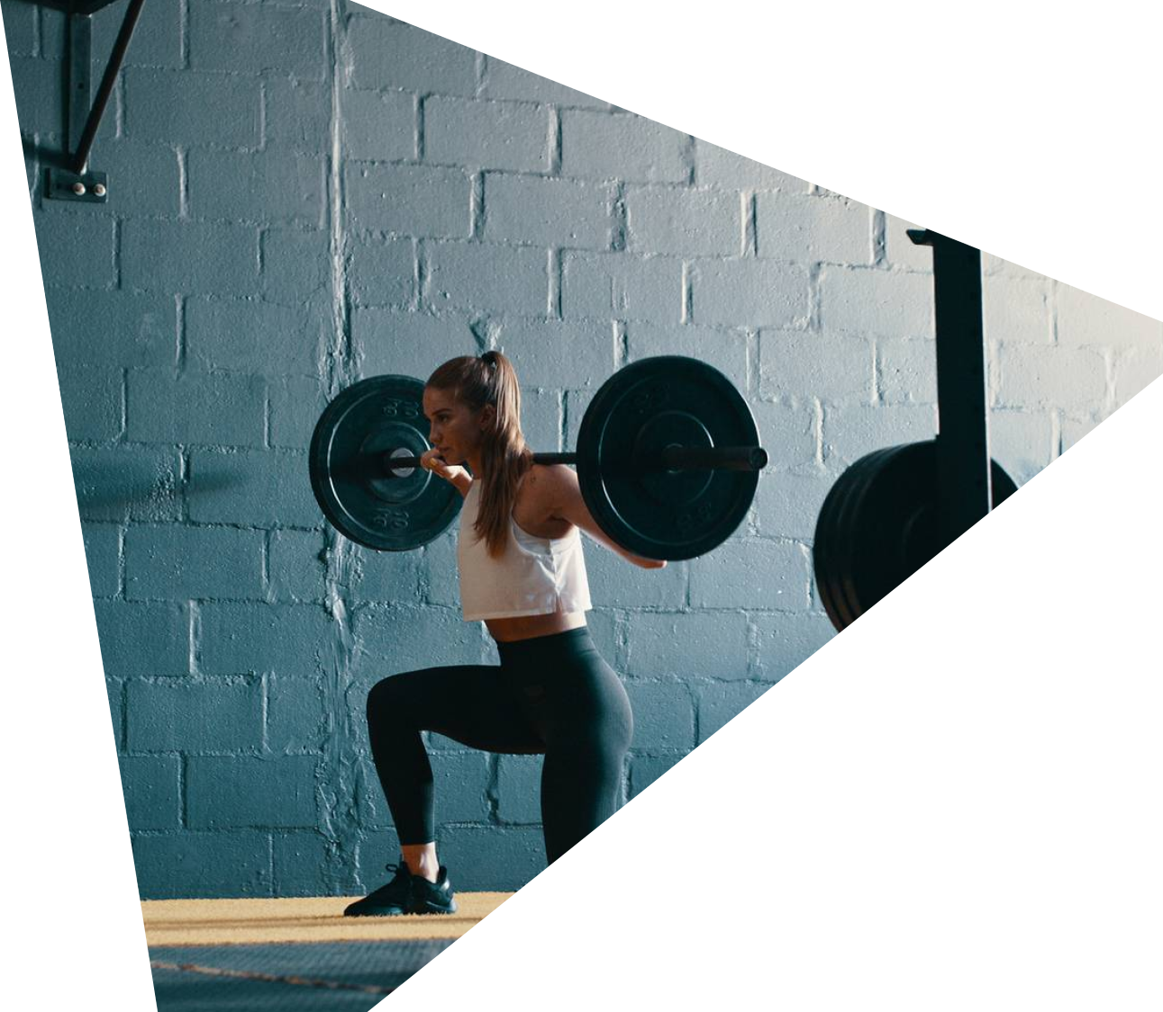
SOLUTION
FITNESS
FITNESS
FITNESS
FITNESS
FITNESS
FITNESS
FITNESS
WHAT IF WE HAD A PERSONAL WORKOUT GENERATOR ?
TO solve the problem of physical inactivity in this tech driven world we’ve come up with the solution of personal workout generator.

Slide 4
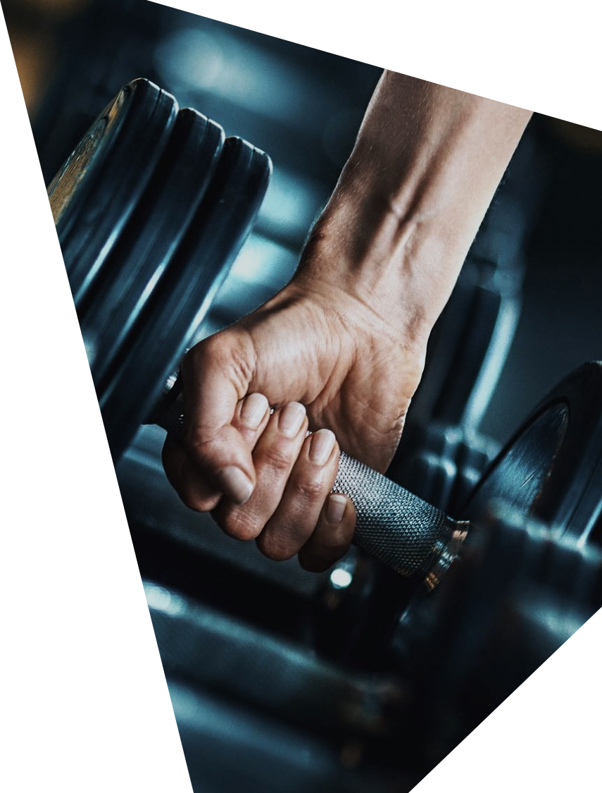
OUR project is a web-based application created using Python that takes in inputs regarding our health status and gives you a workout routine as a deliverable.
What makes our Application unique?
In our application we have included a BMI and BMR calculator , that gives the user an idea of how much energy he/she may consume daily(TDEE) and how healthy they are.
Assigning Fitness levels based on a “Squat Test”, unlike other apps that confuse by giving loads of workouts irrespective of your fitness level.
For users with Advanced Fitness levels and Athletes we have included Sport-Specific exercises and Plyometrics which focuses on advanced athleticism.

Slide 5
FITNESs LEVEL
BREAKDOWN
BEGINNER
intermediate
ADVANCED
LEVEL ASSIGNED BASED ON OUTCOME OF SQUAT TEST.
Sub-divided into various groups based on health conditions.
LEVEL ASSIGNED BASED ON OUTCOME OF SQUAT TEST.
Sub-divided into groups based on health status and fitness goal.
LEVEL ASSIGNED BASED ON OUTCOME OF SQUAT TEST.
Sub-divided workouts into Athlete and Non-Athlete.
A fitness level is assigned to the user based on the outcome of the squat test. This test is a standardized test verified by Total Fitness ebook, by Vince W.Antonetti , Ph.D, who is an emeritus professor at Manhattan College. He is a weight control and fitness expert

Slide 6
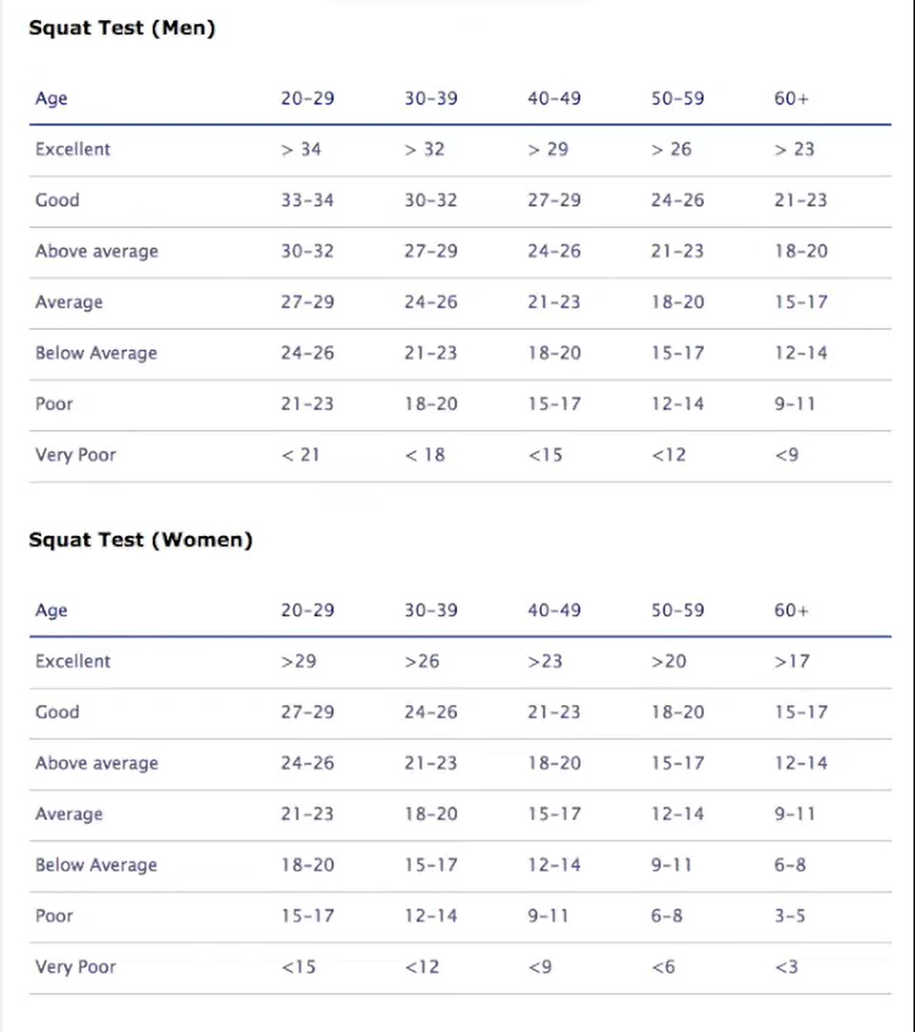
Source : originally taken from Total Fitness ebook, by Vince Antonetti
Advanced
{
}
Intermediate
}
Beginner
Advanced
{
}
Intermediate
Beginner
}

Slide 7
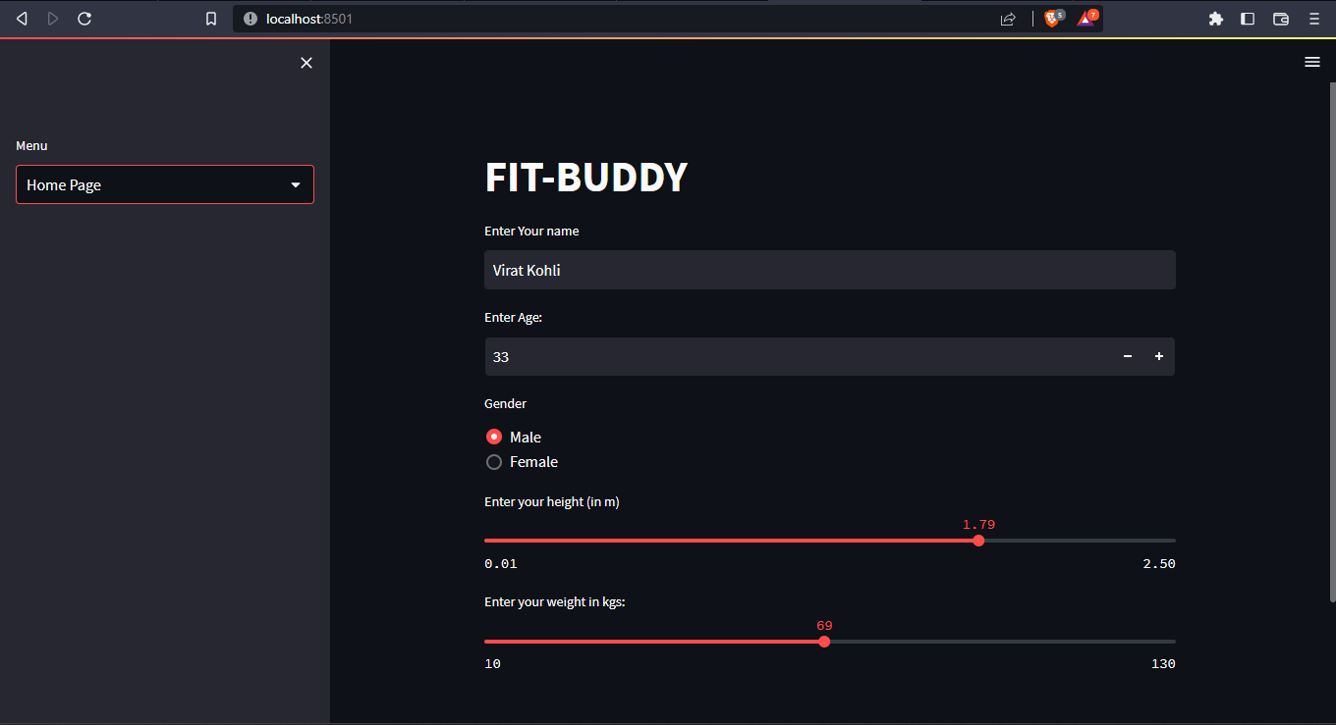
OUTPUTs:

Slide 8
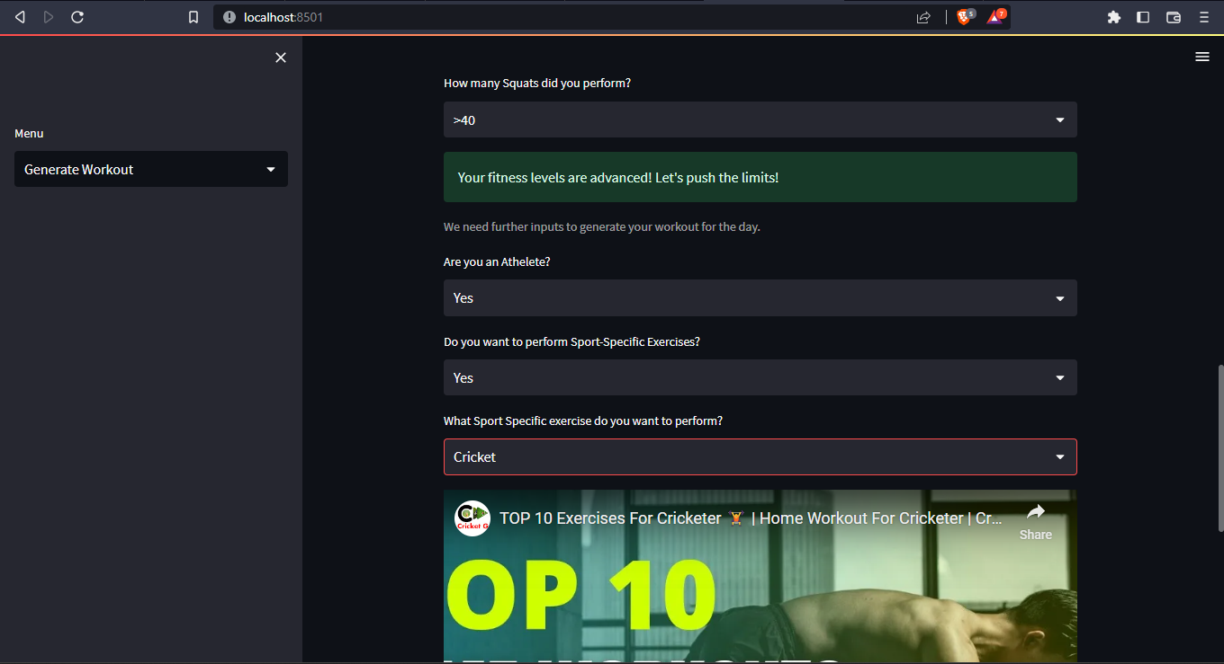

Slide 9
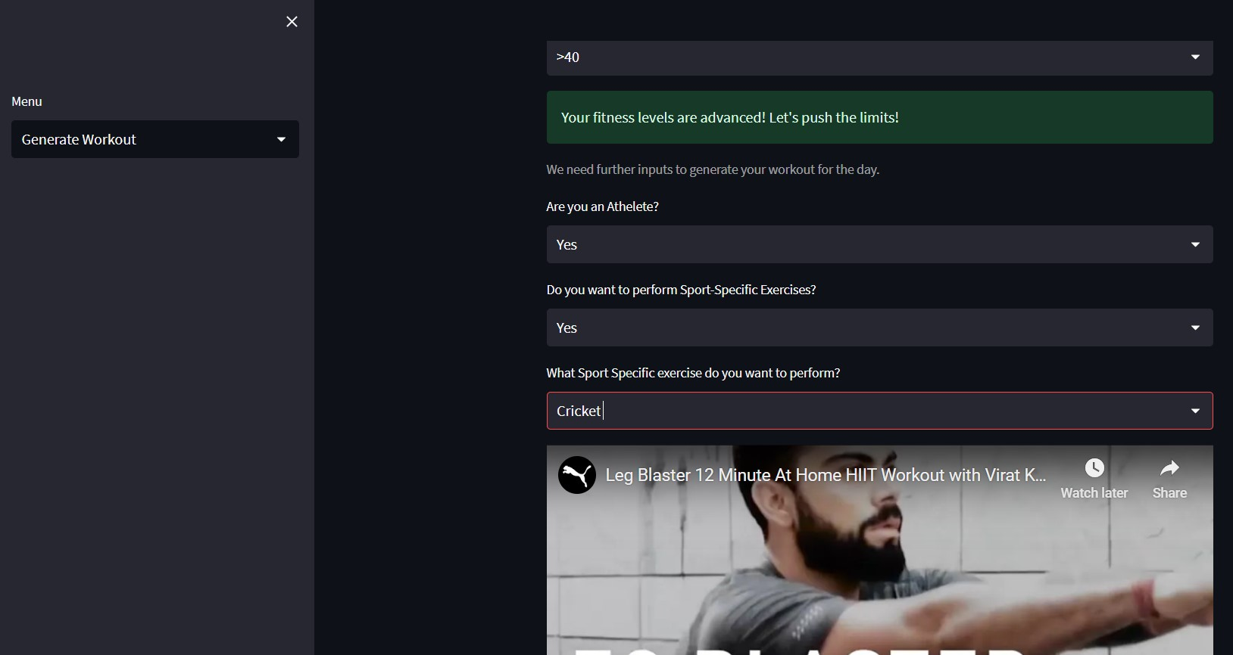
Fit-BUDDY
9

Slide 10


TECHNOLOGY USED:
IDE:
Visual Studio CODE(vsc)
Interpreter:
Python(3.8.10)
Python MODULES USED:
STREAMLIT
RANDOM

Slide 11
FUTURE SCOPE
Can be deployed on web to be made available for all.
Customized workout videos made by a group can be added to application instead of relying on YouTube videos which can lead to the creation of a fitness brand.
Can be implemented in open gyms where there are no trainers so that users can follow a structured workout routine.

Slide 12
Thank you!
DHANUSH KONDAPARTHY
CHILUPURI NALIN
DILEEP RAJ RAVULA
Mr.MANOJ PATIL
1602-21-737-134
1602-21-737-153
1602-21-737-136
MENTOR

